Slide 1
Global Intergenerational Week Assembly
Notes:
There is a focus this week around the world on people of all different ages being friendly.

Slide 2
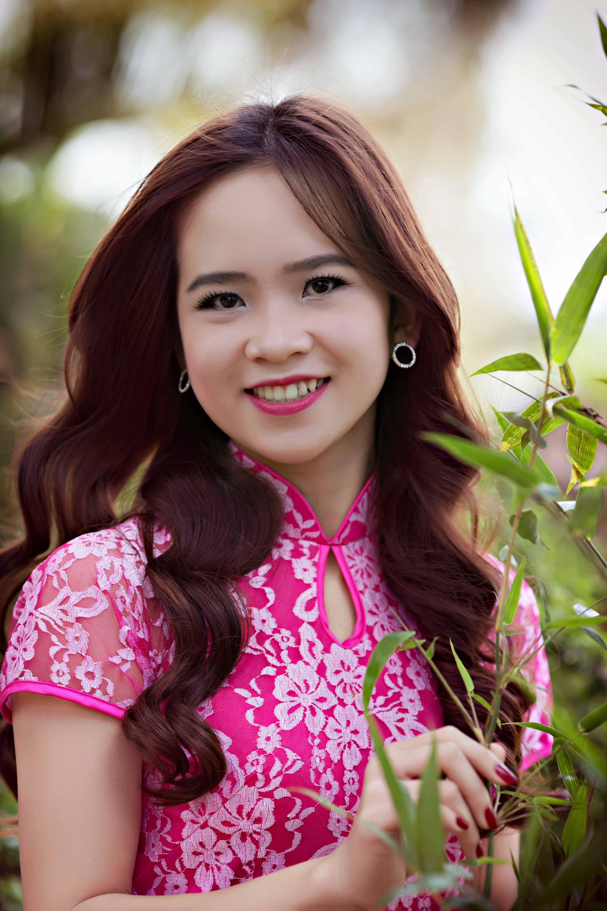
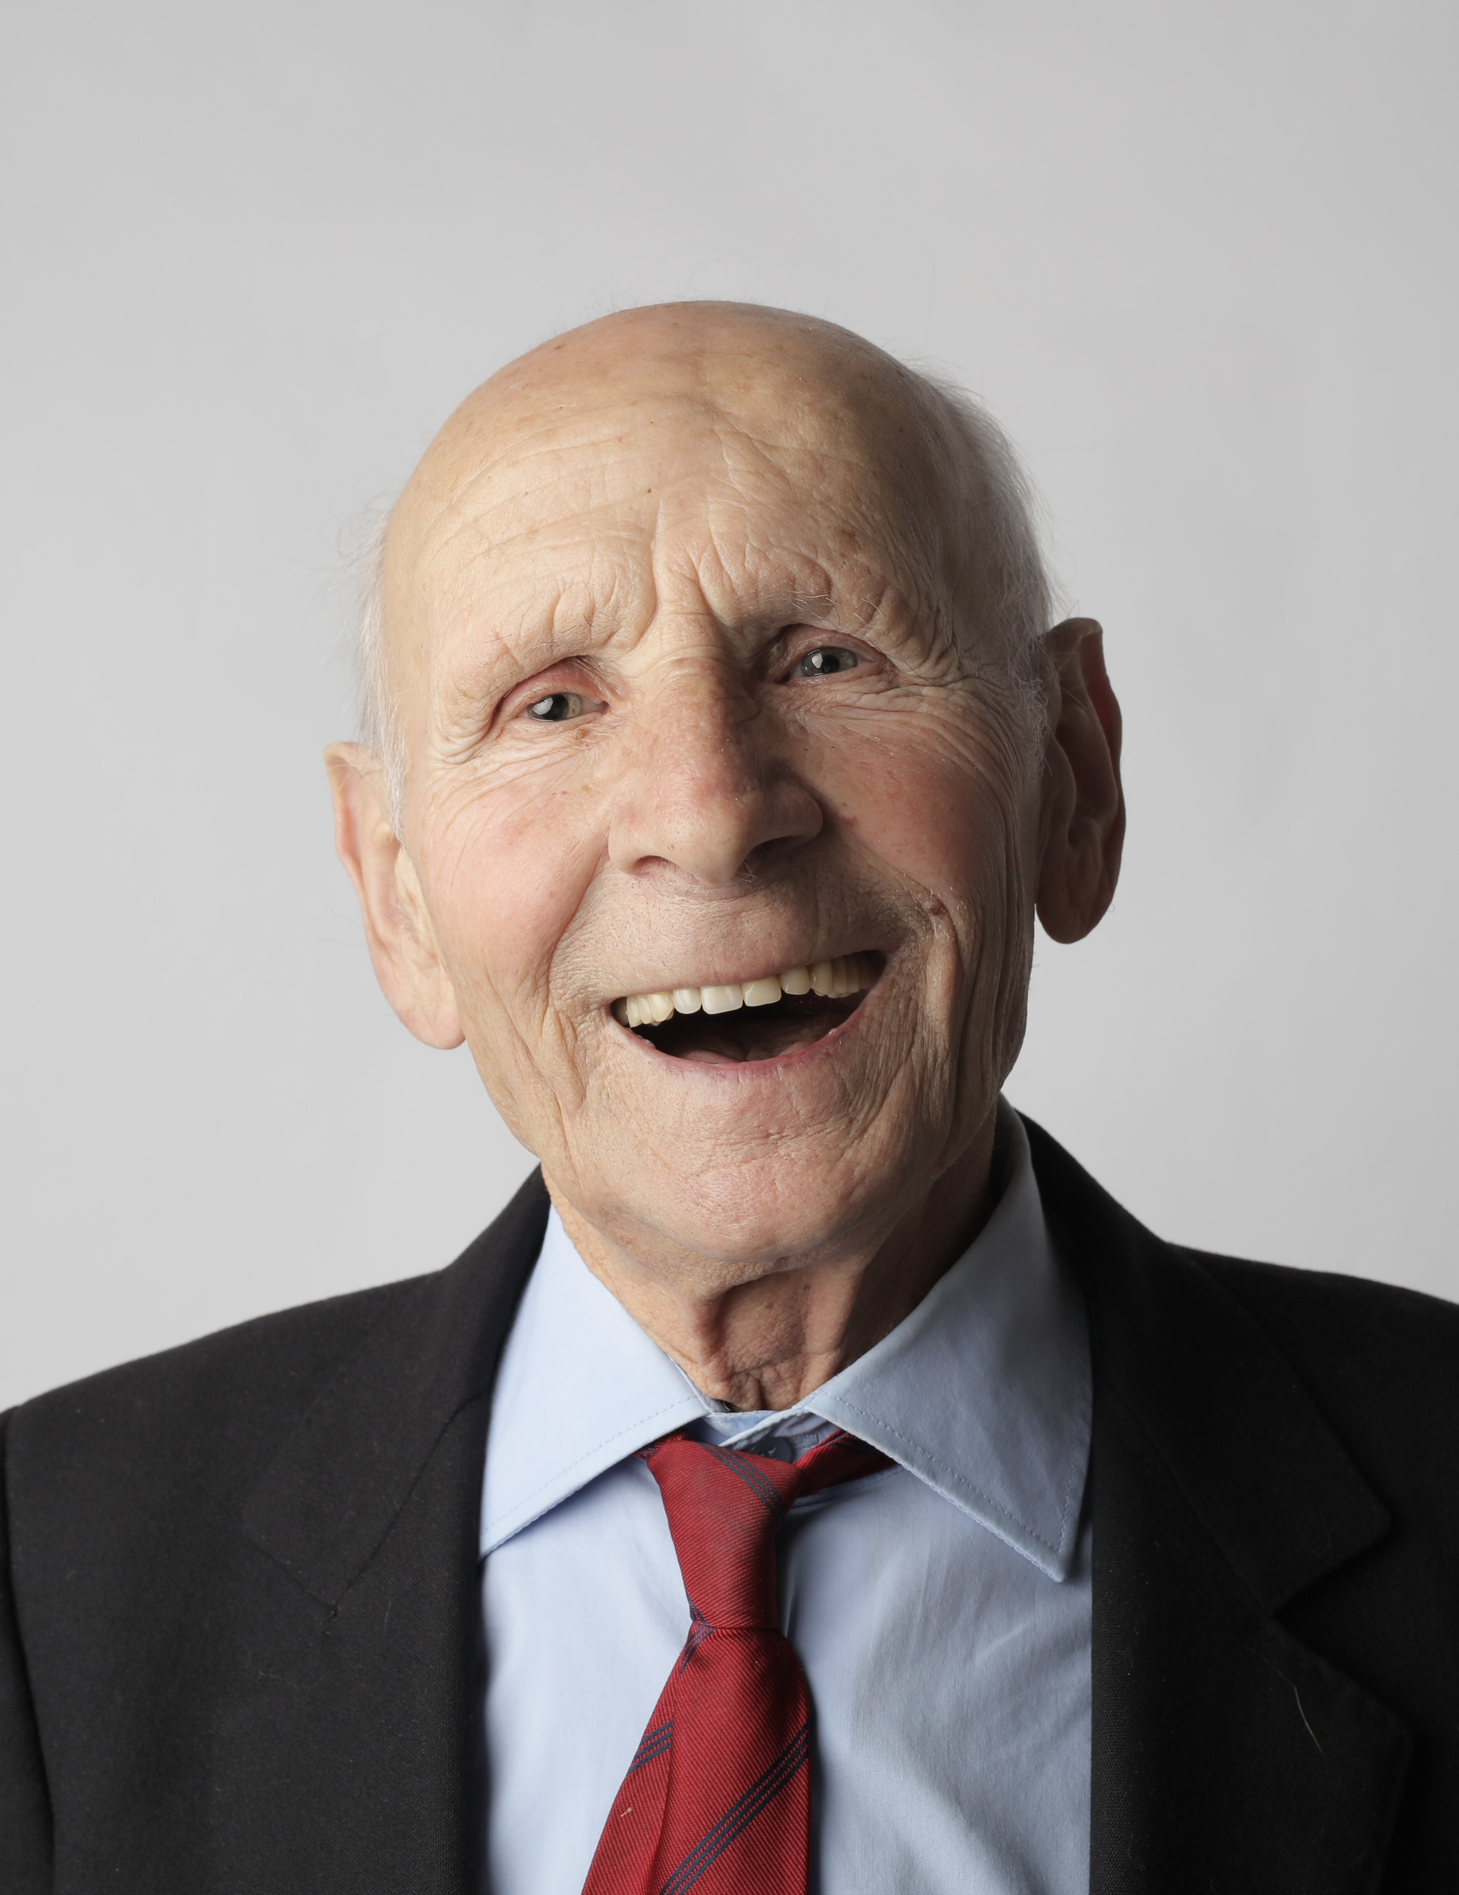
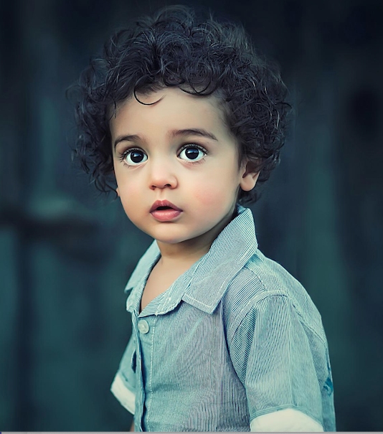
Ages and ageing
What does it mean to be old?
What do you think is the best age and why?
What ages do you think the people below are?
Notes:
Children may talk about signs of age being wrinkles or grey hair or things that people can no longer do so easily (walking for example). Books such as ‘The lines on Nana’s face’ by Simona Ciraolo or ‘Wrinkles’ by JR are short and primary friendly texts that develop the idea of wrinkles as a natural part of ageing and a sign of adventures, wisdom and memories.
Image credits: left and centre: pexels, right: pixabay

Slide 3
Ages and ageing
What might you look like and what might you be doing when you are “old”?
https://www.youtube.com/watch?v=6ht-amIfOnU
Notes:
Draw attention to the fact that we will all most likely be “old” one day!

Slide 4
Generations
What does ‘generation’ and ‘intergenerational’ mean’?
Do you think it’s a good idea to mix with people of different ages? Why/ why not?
baby
child
adult
older
person
Notes:
Definitions: generation – all the people born and living at the same time. You might hear people talk about ‘the older or younger generation’.
Intergenerational – different ages and generations mixing together

Slide 5
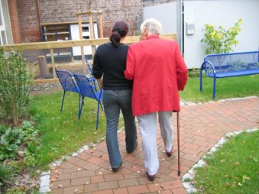
What is a care home?
A care home is a place where older people live together and are cared for.
Sometimes older people choose to live in a care home to get extra help that they need.
They might need help with getting dressed, taking medicines or getting around safely. Every person is different and has different needs.
Notes:
You may to ask the children if they have any experience of a care home/ have a family member who works in one.
image: pixabay

Slide 6
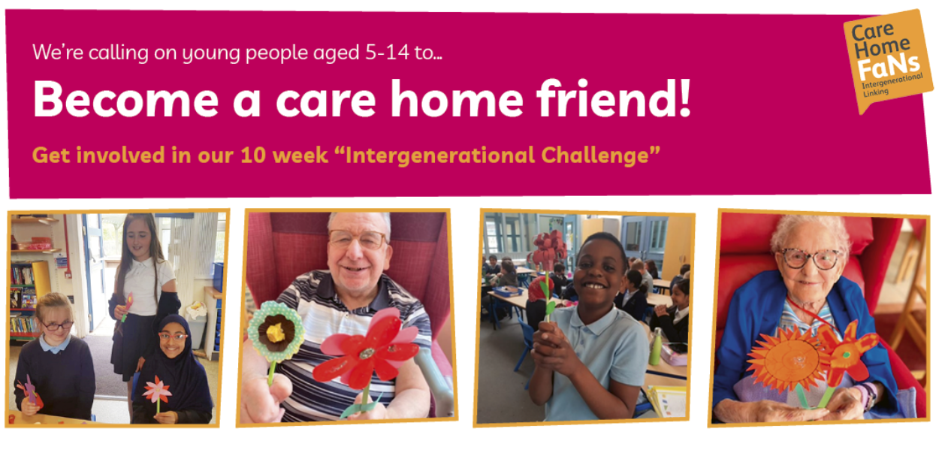
Become a care home friend challenge
Notes:
You may have classes or families taking part in the care home friend challenge: https://myhomelife.org.uk/community-engagement/intergenerational-linking/care-home-friend-challenge/ . You can highlight the challenge ( a weekly activity over 10 weeks learning about care homes and making something to send to your local care home) and encourage others to take part at home. Each child that takes part will receive a certificate.

Slide 7
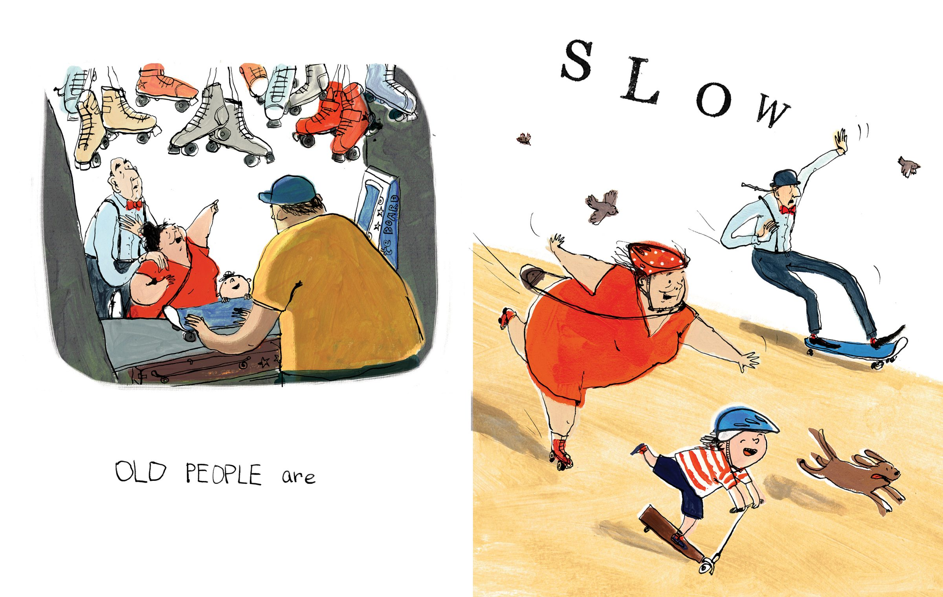
Intergenerational connections
What could we learn and enjoy from connecting with older people?
https://www.youtube.com/watch?v=QiT3vSQrJyc
Notes:
The youtube video link is around 4 mins long and is the author reading a picture book demonstrating how older people are amazing. Children might think about benefits of connecting with older people being some of the following: friendship, learning new things, helping others.

Slide 8
Time to reflect
What will you remember?
What are you going to do next?
Notes:
Even if children aren’t taking part in the challenge, they may want to think about other actions of kindness and connection they could do for an older person in their family or neighbour.
Faith schools may like to say a prayer as part of their reflection time.
Image: pixabay

